Slide 1
Abnormal Labour
Sanjeewa Padumadasa

Slide 2
Prolonged labour is associated with
high level of maternal and fetal mortality obstructed labour
sepsis
PPH
uterine rupture

Slide 3
Definition of normal labour
From the onset of uterine contractions that are associated with effacement and dilatation of the cervix with descent of the presenting part.
Results in the birth of the baby followed by delivery of the placenta.

Slide 4
Stages
1st stage : onset of labour to full cervical dilatation
Latent phase : onset to 4 cm
Active phase : 4 cm to full cervical dilatation
2nd stage : full cervical dilatation to delivery of the baby
3rd stage : delivery of the baby to delivery of the placenta

Slide 5
First stage of labour
From the time of admission to labour room to full dilatation of cervix.
Divided into latent and active phases.

Slide 6
Second stage of labour
Full dilatation of the cervix to delivery of the fetus
Divided into pelvic and perineal stages

Slide 7
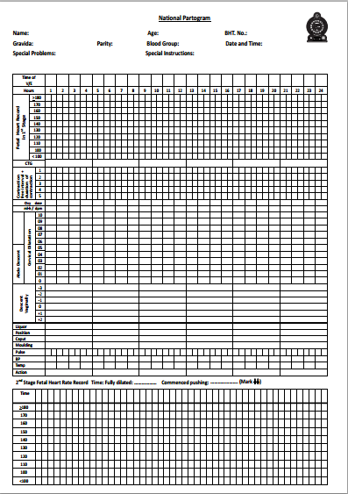

Slide 8
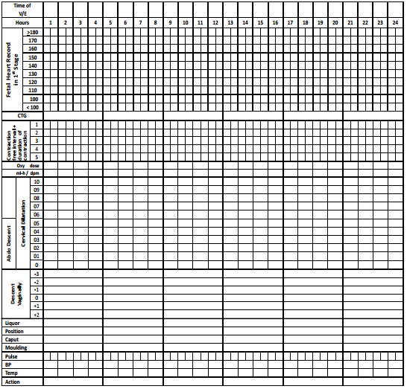
Fetal heart rate
Details of CTG
Frequency & intensity of uterine contractions
Dose & route of Oxytocin
Cervical dilation
Descent vaginally
Liquor
Position
Caput/Moulding
Observations of the mother
Pulse rate
Blood pressure
Temperature

Slide 9
Documentation of cervical dilatation
Alert line - to be drawn (1 cm per hour) when cervical dilatation > 4 cm
Action line - to be drawn (1 cm per hour) 4 hours to the right of the alert line

Slide 10
Eg: cervical dilation is 4cm, when it is checked for the first time in labour room
In this example partogram has started when cervical dilation was 5cm.
Look how the alert line was drawn from the point where cervical dilation was more than 4cm for the first time.
 |  | 10
 |  | 9
 |  | 8
 |  | 7
 |  | 6
 |  | 5
 |  | 4
 |  | 3
 |  | 2
 |  | 1
 |  | 0
Alert line
Cervical dilation
Cervical dilation
Action line
abdominal descent
4 hours
Abdominal descent

Slide 11
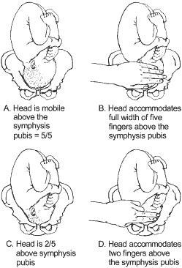
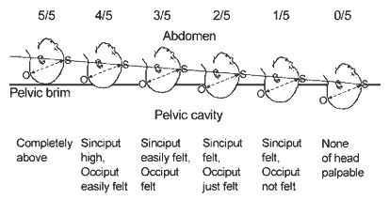
Abdominal descent of the fetus

Slide 12
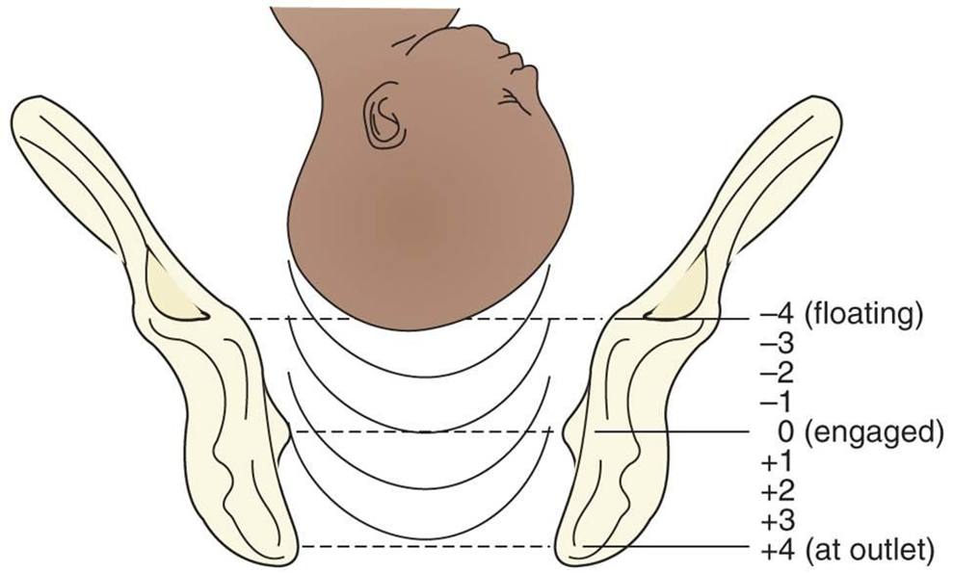
Descent

Slide 13
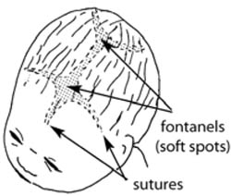
Documentation about liquor
I (Intact membranes)
C (Clear)
M (Meconium)
B (Blood stained)
A (Absent)
Degree of moulding to be documented as:
0 Bones separated, suture lines felt easily.
+ Bones just touching each other
++ Bones overlapping
+++ Bones overlapping severely

Slide 14
Complications of dysfunctional labour
Anticipate for PPH following delivery after a dysfunctional labour
uterine atony secondary to prolonged labour
Especially if complicated with chorioamnionitis
Caesarean section
Instrumental delivery
Shoulder dystocia
Trauma during delivery ( mother and baby)

Slide 15
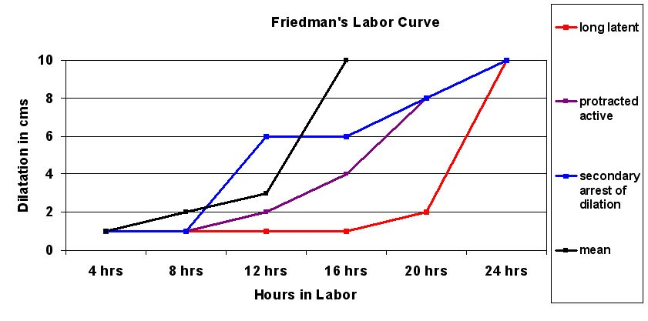
Partogram – abnormal labour

Slide 16
Disorders of labour
Prolonged latent phase
Primary dysfunctional labour
Secondary arrest

Slide 17
Prolonged latent phase
Remodeling and effacement of the cervix.
Upto 20 hours (average 8.6) in nulliparae and 14 hours (average 5.3) in multiparae.
Careful explanation and adequate analgesia may be all that is needed .

Slide 18
Primary dysfunctional labour
Defined as poor progress during the active phase of labour.
Affects 26% of nullipare and 8% of multipare.
Poor / inco-ordinate uterine activity is a significant factor.

Slide 19
Primary dysfunctional labour
Hydration alone : 40% improve
One to one care (Talk to patient, explain)
Mobilize
Maternal companion
Good analgesia
Augmentation
Oxytocin 70% nullipara and 80% multipara will respond

Slide 20
Secondary arest
Defined as cessation of cervical dilatation following normal period of active phase dilatation.

Slide 21
3 Ps
Passage
Passenger
Power

Slide 22
Passage
Bony components of the pelvis
eg :- skeletal dysplasia,rickets,pelvic fracture
Soft tissues
eg :- impacted rectum, full bladder, cervical
fibroids, vaginal atresia, vaginal septum

Slide 23
Passenger
Fetal macrosomia – diabetes, post dates
Malpresentation
Malposition
Deflexed head
Feto-pelvic disproportion
Hydrocephalus,conjoined twins

Slide 24
malpresentations
Face (mentoposterior position)
Brow
Shoulder
Compound presentation

Slide 25
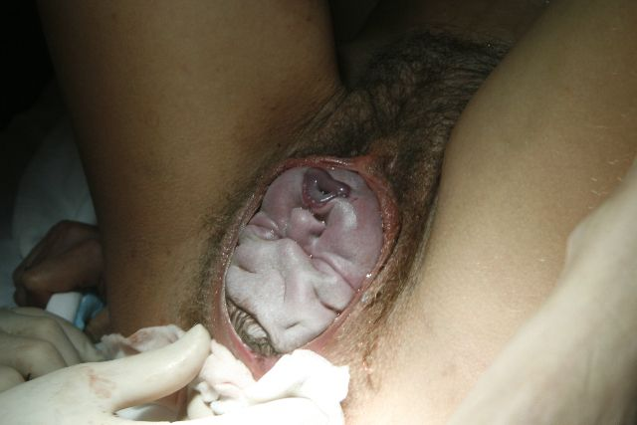
Face presentation

Slide 26
Brow presentation
Is due to deflexed head
Presenting diameter is the mentovertical
13 cm
Management – conservative, oxytocin, LSCS

Slide 27
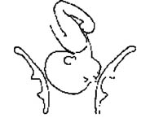
Brow presentation

Slide 28
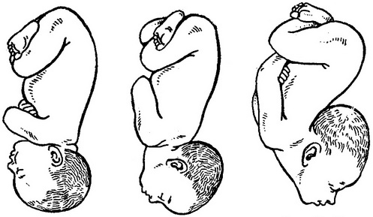
Deflexed, brow and face

Slide 29

Shoulder presentation

Slide 30
Malpositions
Occipito-posterior
Occipito-lateral

Slide 31
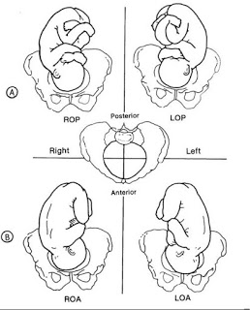

Slide 32
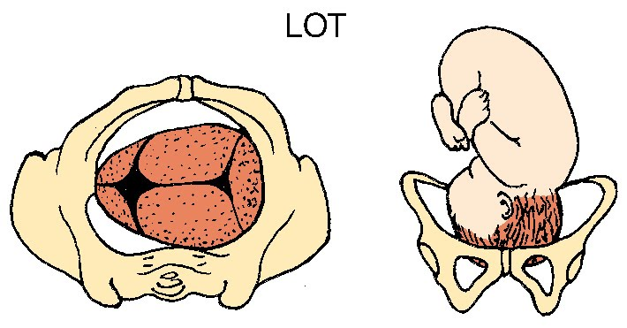
Deep transverse arrest

Slide 33
Relative CPD
Usually suboccipito-bregmatic diameter
Well flexed occipito-anterior position
9.5 cm
Larger occipitofrontal diameter (deflexed head), 11 cm will result in relative CPD

Slide 34
Dimensions of presenting part change through
  Flexion
  Rotation
  Moulding
There are subtle changes in the pelvis

Slide 35
Power
Uterine contractions –originate in upper uterine segment and propagate towards lower segment.
Muscles contract,relax,retract.

Slide 36
Power contd……
Oxytocin increases the
  Frequency
  Intensity
  Duration of uterine contractions

Slide 37
Obese, eldery, diabetic women are more likely to have dysfunctional labour than others.

Slide 38
Assessment of a patient
Estimated fetal size
Degree of engagement
Position of the presenting part
Signs of obstruction – caput, moulding
Descent of the presenting part with contractions
Frequency of contractions
Fetal well being

Slide 39
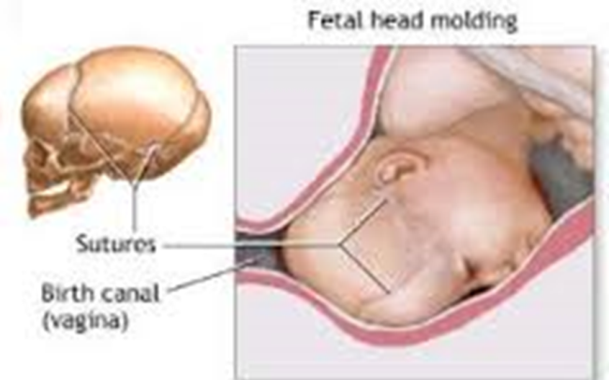
Assessment of dysfunctional labour
Examine
Must always do an abdominal examination prior to vaginal examination
Abdomen : Uterine contractions can be felt/ how frequently
Is the presentation Cephalic?
Descent of the presenting part
Is the bladder full and palpable?
Vaginal : Dilatation and effacement of cervix
Descent and station of the presenting part
confirm presentation is vertex / brow / face
position of the fetal head occipito anterior / transverse / occipito posterior
Features of early obstruction of labour (caput/moulding)
Liqour colour

Slide 40
Treatment
Pain relief
Hydration
Mobilization
Amniotomy
Augmentation with oxytocin
LSCS in the event of fetal distress

Slide 41
Second Stage
Consists of
Passive phase (Descent phase)
Active phase (Expulsive phase)
Delay in second stage
Nullipara : 2 hours from onset of active phase
Multipara : 1 hour from onset of active phase
With epidural analgesia can allow 1 additional hour

Slide 42
Treatment for poor progress in the second stage
Wait
Instrumental vaginal deliveries
Caesarean section

Slide 43
Amniotomy
Routine amniotomy is not associated with reduction in duration of first stage.
It is associated with increased rate of caesarean sections.
Therefore should be reserved to abnormal progress in labour.

Slide 44
oxytocin
Effective in inefficient and inco-ordinate uterine contractions.
Should be cautious in multiparous women.

Slide 45
Oxytocin contd…
Aim is to provide 4 contractions in 10 min, each contraction lasting approximately 40 seconds.
Period of augmentation more than 8 hours is unlikely to result in successful vaginal delivery in the presence of poor progress.

Slide 46
Oxytocin
Infusion pump recommended
If not available can use gravity assissted drip system
5 units in 500 ml 0.9% saline drop rate 15 drops/minutes and increased by 15 drops/minute every 30 minutes to a maximum of 60 drops/minutes

Slide 47
Oxytocin Use
Drop rate / min | Equivalent mU/min
15 | 7.5
30 | 15
45 | 22.5
60 | 30

Slide 48

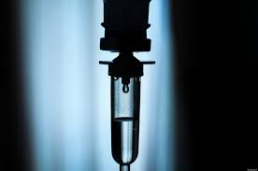
Oxytocin side effects
Uterine Hyperstimulation
Amniotic fluid embolism
Water Intoxication
Vomiting
Hypotension
Arrhythmias
Uterine rupture

Slide 49
Provision of continuous professional support in labour reduces operative interventions and need for pain relief, shortens labour and lead to infants being delivered in better condition.

Slide 50

Precipitous labour
Labour duration <3hrs
Common in multipara and grand multipara following abruption, meconium
Anticipate PPH (uterine atony), uterine rupture if cervix not compliant, amniotic fluid embolism, perineal, vaginal and cervical tears

Slide 51
Take home message
Dysfunctional labour can occur anytime during labour. As house officers in first contact with patients in labour room you must be vigilant to detect it early.
Main types are
  Prolonged latent phase
  Primary dysfunctional labour
  Secondary arrest

Slide 52
Take home message
Dysfunctional labour requires thorough assessment for cephalo pelvic disproportion and fetal well being.
Simple measures such as hydration, analgesia and one to one care should not be overlooked.
Augmentation with oxytocin although effective should be decided by a senior as it can be a dangerous drug for both the mother and the fetus.

